Slide 1


CS Bridge

Slide 2
What is a computer scientist?

Slide 3
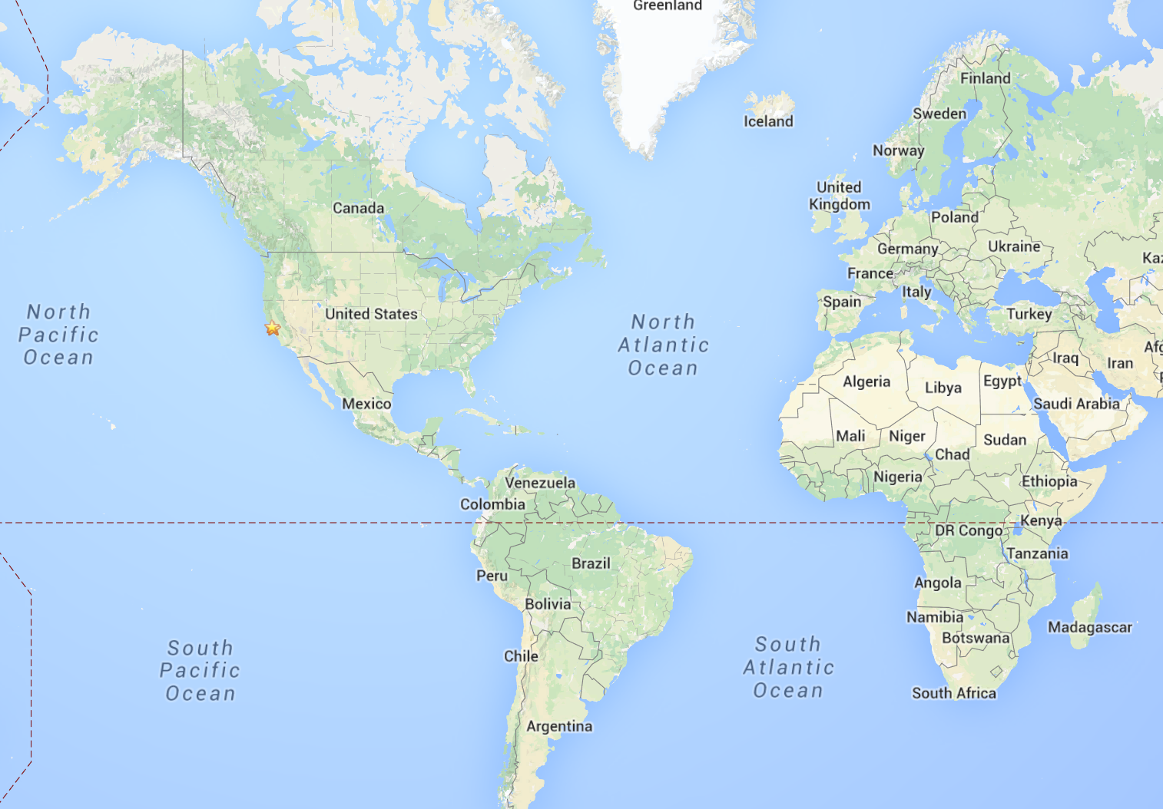
Stanford?
Notes:
Call me Chris
I grew up in a bunch of places.
I’m a PhD in Artificial Intelligence
Everyone once in a while they let me teach, even though I’m young.
Mostly because I get so excited.
Actually I got my first chance to teach because of the facebook like button… but that’s a story for another day.

Slide 4
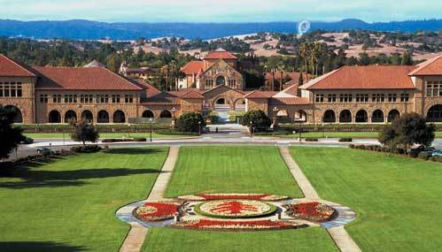
Stanford

Slide 5
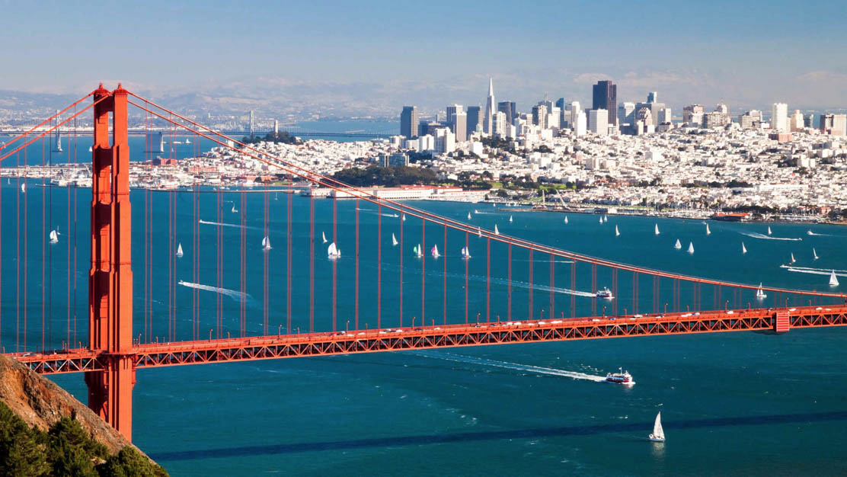
Near San Francisco

Slide 6
Kenya
Notes:
We want all of you to be successful
That’s why we have such a large course staff
And its not like it’s a ya-ya course where we all hold hands and sing koombaya. Its real material.
But over years and years and years we have been working on our material so that everyone gets through…
Your going to get your moneys worth… but as I understand it this course is free so hopefully you get more than your money’s worth ☺
Not competing against anyone but yourself

Slide 7
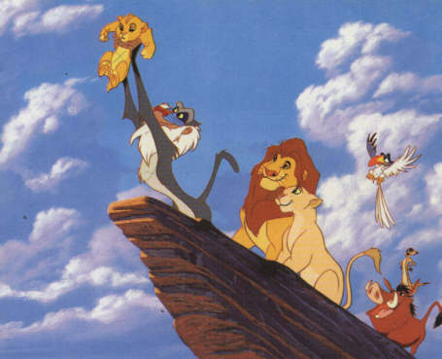
Kenya
Notes:
We want all of you to be successful
That’s why we have such a large course staff
And its not like it’s a ya-ya course where we all hold hands and sing koombaya. Its real material.
But over years and years and years we have been working on our material so that everyone gets through…
Your going to get your moneys worth… but as I understand it this course is free so hopefully you get more than your money’s worth ☺
Not competing against anyone but yourself

Slide 8
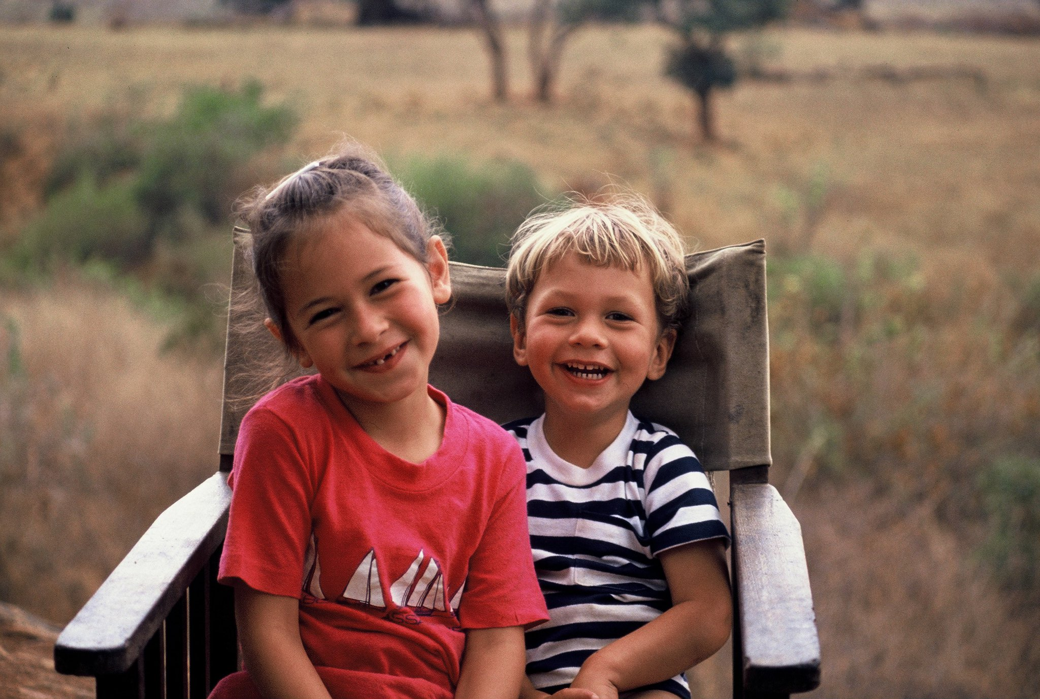
Kenya
Notes:
We want all of you to be successful
That’s why we have such a large course staff
And its not like it’s a ya-ya course where we all hold hands and sing koombaya. Its real material.
But over years and years and years we have been working on our material so that everyone gets through…
Your going to get your moneys worth… but as I understand it this course is free so hopefully you get more than your money’s worth ☺
Not competing against anyone but yourself

Slide 9
Logistics

Slide 10
Course Website
http://csbridge.org
*note that its org not com

Slide 11
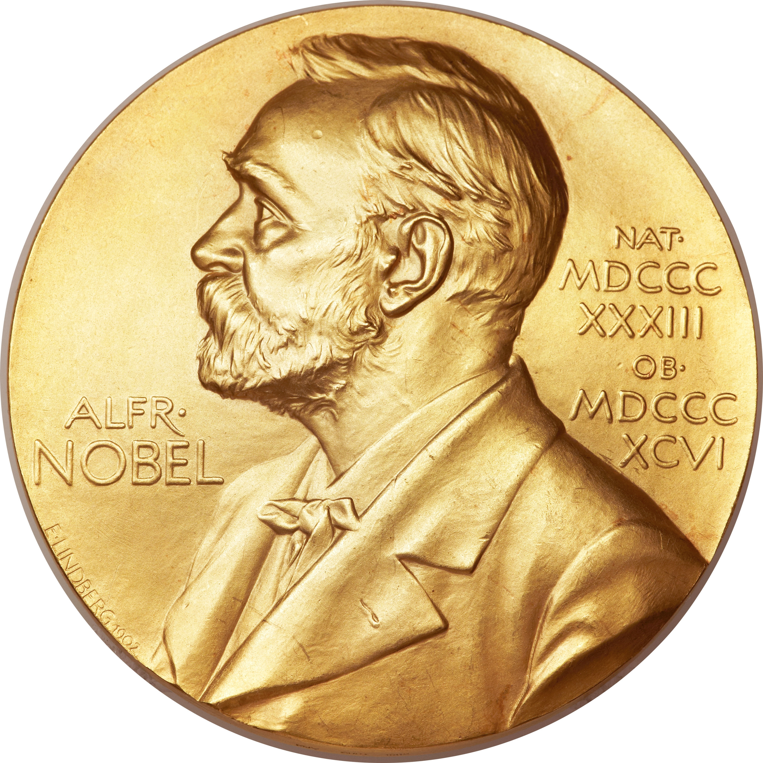
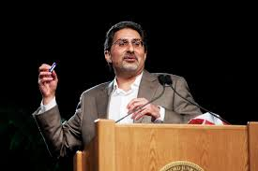
Prize Policy

Slide 12
Are there any questions?
Notes:
We want all of you to be successful
That’s why we have such a large course staff
And its not like it’s a ya-ya course where we all hold hands and sing koombaya. Its real material.
But over years and years and years we have been working on our material so that everyone gets through…
Your going to get your moneys worth… but as I understand it this course is free so hopefully you get more than your money’s worth ☺
Not competing against anyone but yourself

Slide 13
About the class

Slide 14
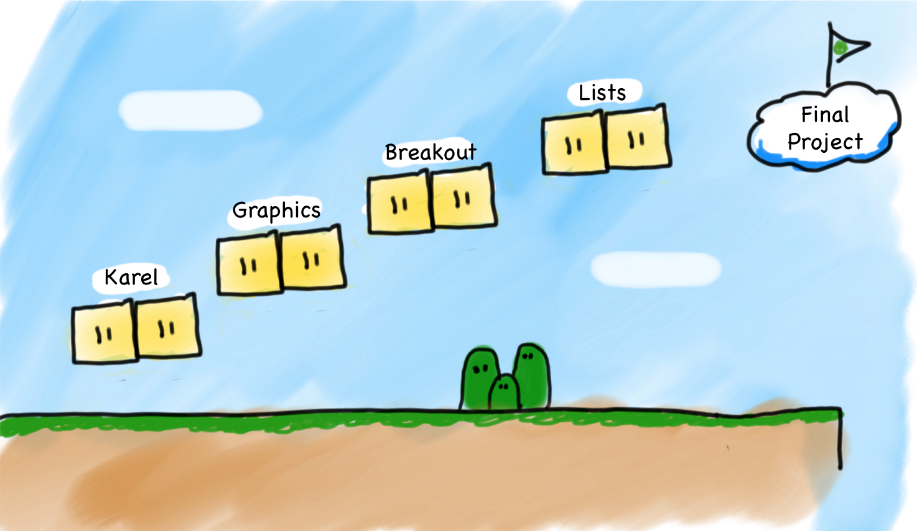
Very High Level

Slide 15
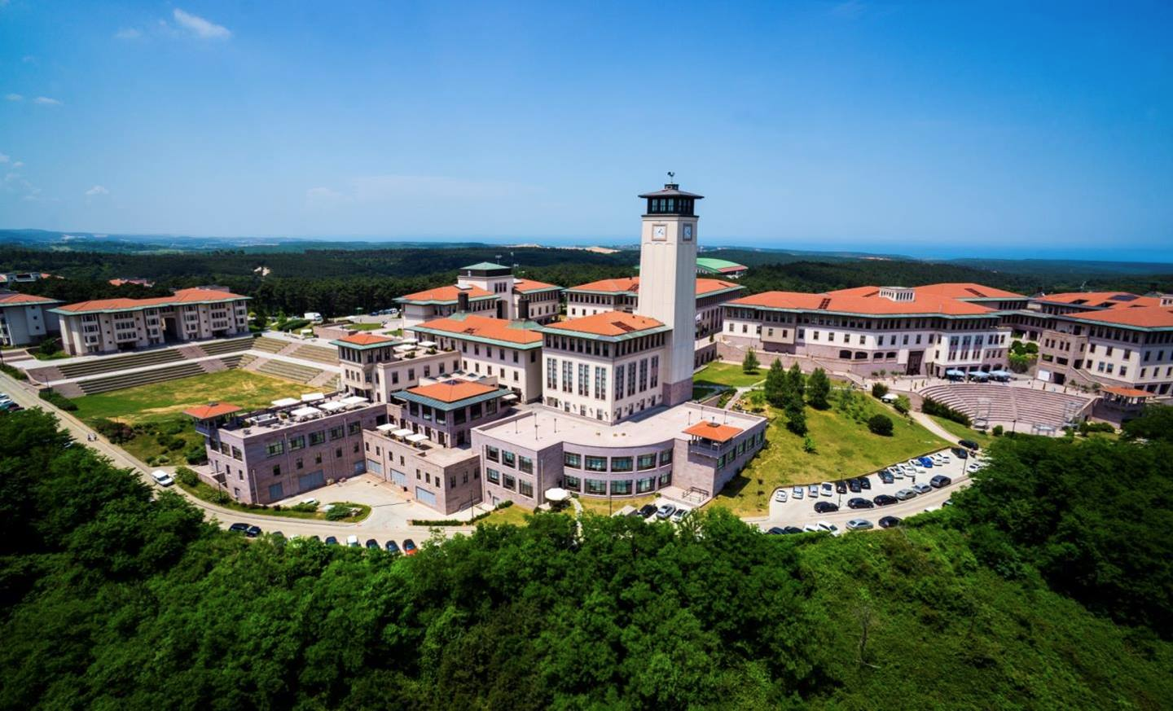


Joint Effort

Slide 16
Material From
CS106A
Comp 130
Notes:
700 students
Most students at stanford take the course.
You are going to get the same matrial, and the same respect that we would give to students back home..
And your like… but you are throwing candy and stuff. Yep this is whats its like there too

Slide 17
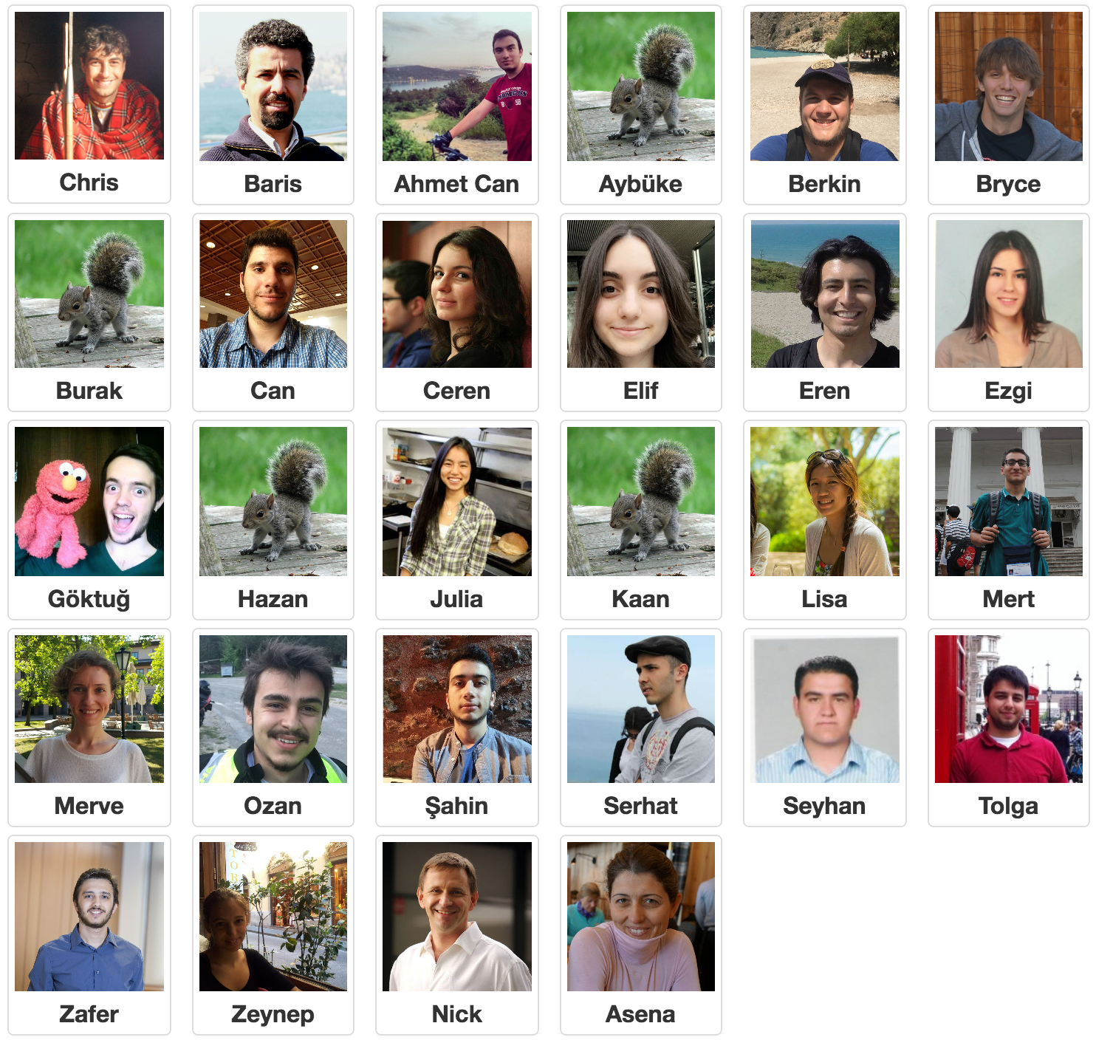
Great Team
Notes:
700 students
Most students at stanford take the course.
You are going to get the same matrial, and the same respect that we would give to students back home..
And your like… but you are throwing candy and stuff. Yep this is whats its like there too

Slide 18
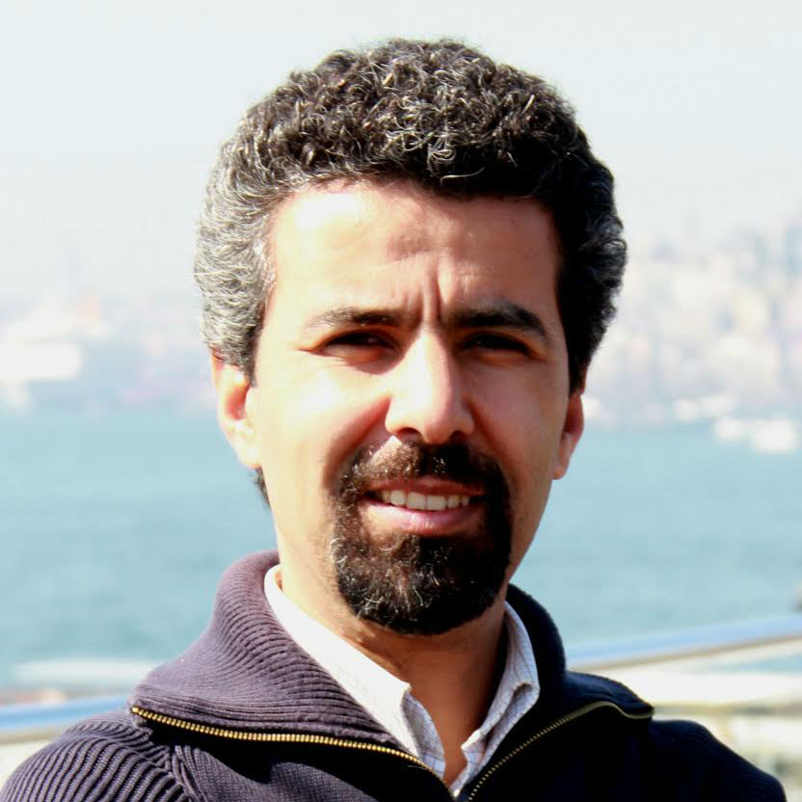
Baris

Slide 19
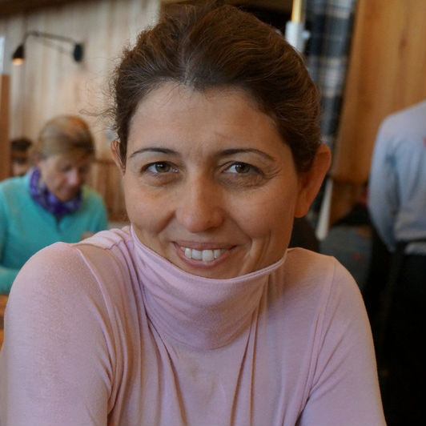
Asena

Slide 20
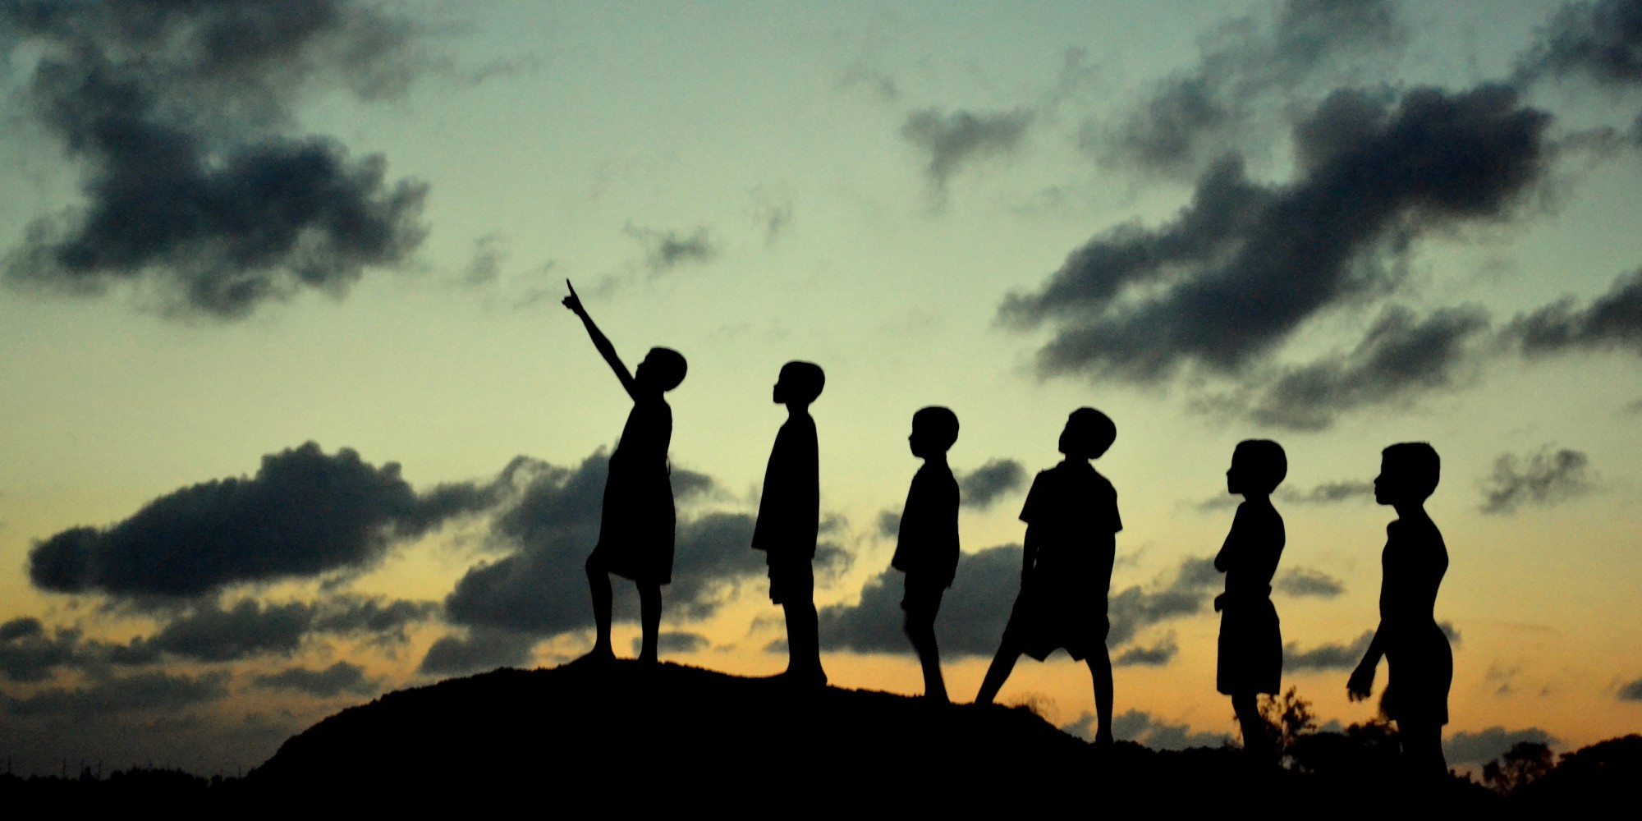
Section Leader
Notes:
700 students
Most students at stanford take the course.
You are going to get the same matrial, and the same respect that we would give to students back home..
And your like… but you are throwing candy and stuff. Yep this is whats its like there too

Slide 21
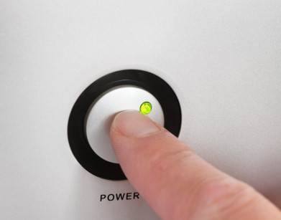
Prerequisites
Notes:
Just need to know how to turn on a computer.
In fact about 8 years ago I was in your seats learning programming.
… and then I did the grad school thing and the teaching thing.
It worked out.

Slide 22
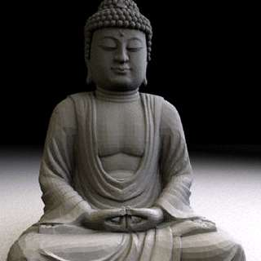
Computer Science
Notes:
We teach software engineering principles. Much larger than just programming.
Mechanics of the language are nothing compared to the principles.
You are going to learn the principles by programming in Java

Slide 23
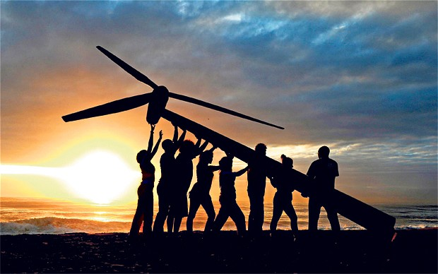
Everyone Succeeds
Notes:
We want all of you to be successful
That’s why we have such a large course staff
And its not like it’s a ya-ya course where we all hold hands and sing koombaya. Its real material.
But over years and years and years we have been working on our material so that everyone gets through…
Your going to get your moneys worth… but as I understand it this course is free so hopefully you get more than your money’s worth ☺
Not competing against anyone but yourself

Slide 24
Breakout
Notes:
We want all of you to be successful
That’s why we have such a large course staff
And its not like it’s a ya-ya course where we all hold hands and sing koombaya. Its real material.
But over years and years and years we have been working on our material so that everyone gets through…
Your going to get your moneys worth… but as I understand it this course is free so hopefully you get more than your money’s worth ☺
Not competing against anyone but yourself

Slide 25
What if I fall behind?

Slide 26
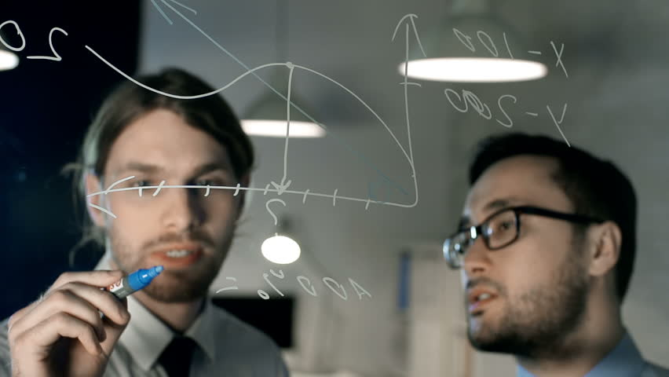
Share Ideas Not Code
Notes:
There are a lot of us! Almost 100 people. And we are all going to walk out of this course knowing Java. To make that work

Slide 27
Why?

Slide 28

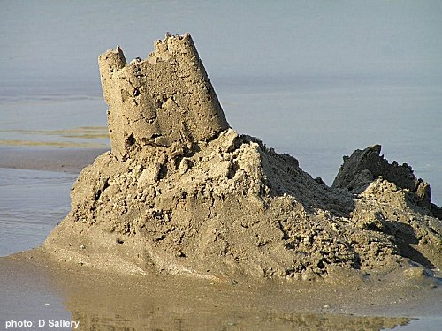
Joy of Building

Slide 29


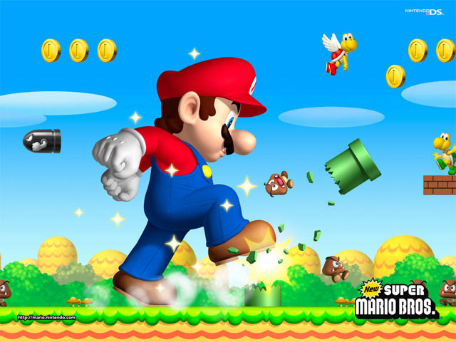

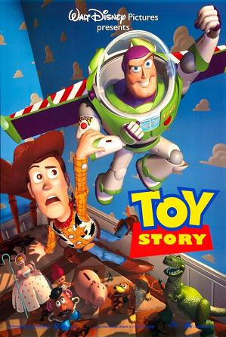
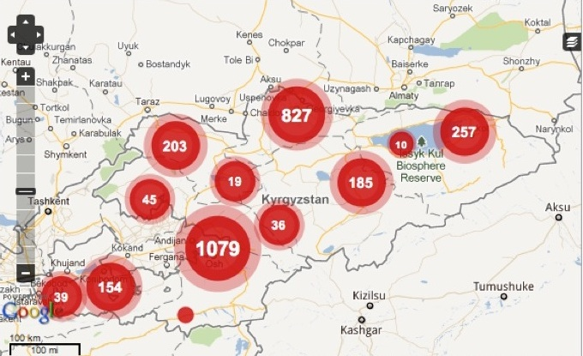
Joy of Building
Notes:
Super Mario: Japan
Angry Birds: Finland
Pixar: USA
Ushahidi: Kenya

Slide 30

Closest Thing To Magic

Slide 31
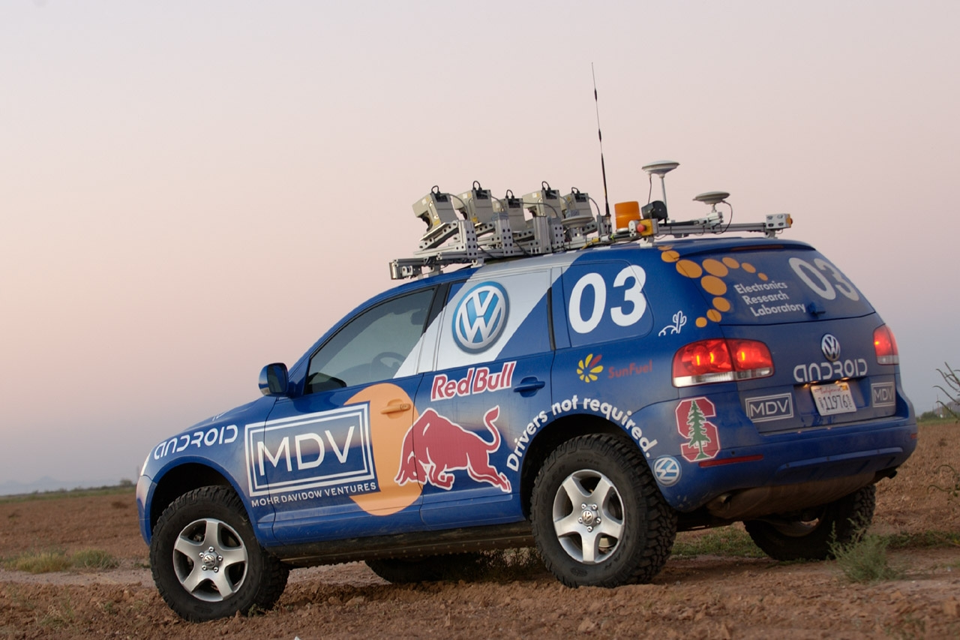

Now is the Time

Slide 32

Everyone is Welcome

Slide 33
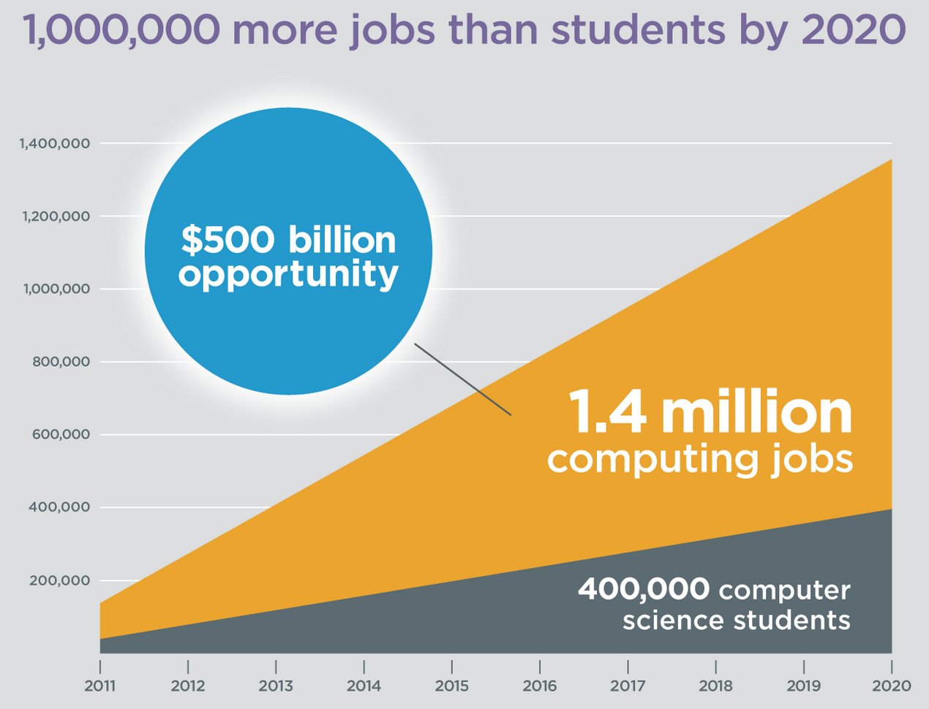
Oh and Its Useful
Code.org

Slide 34
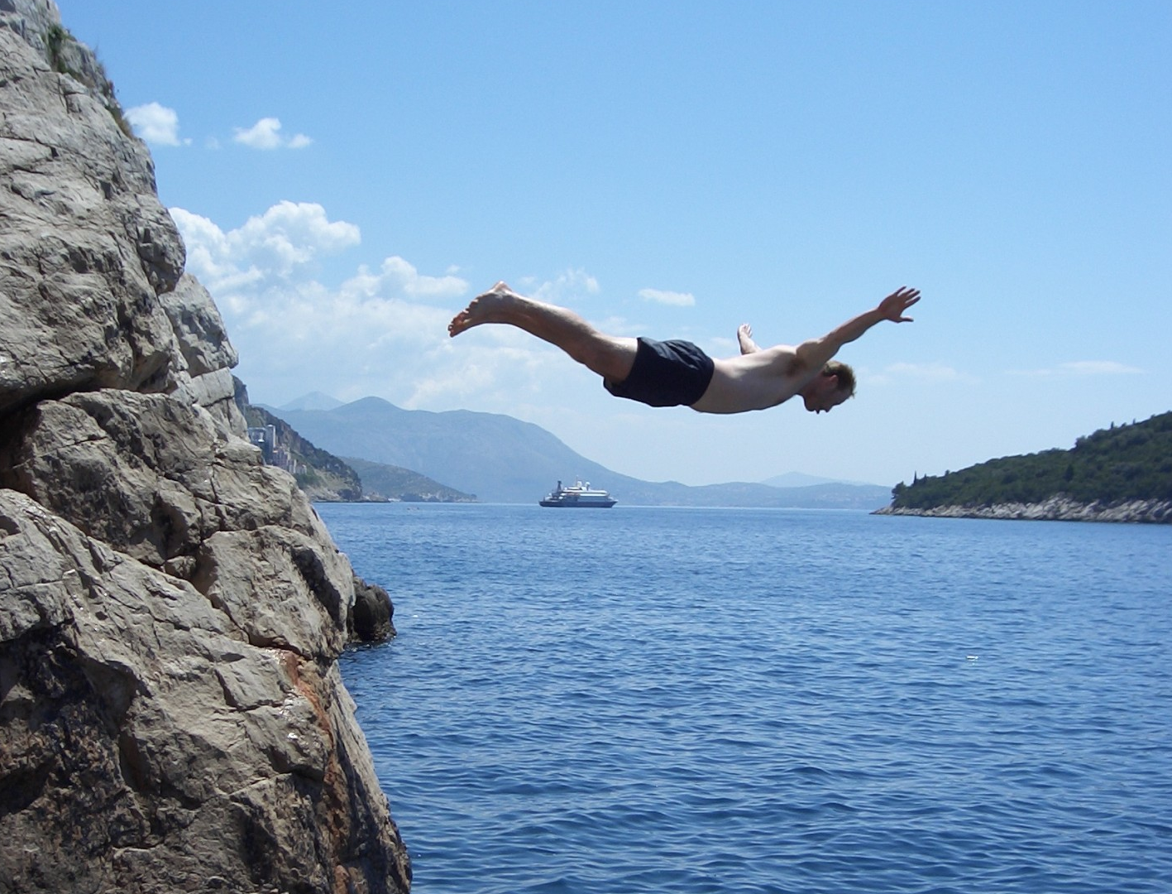
Lets Get Started

Slide 35
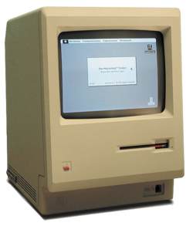
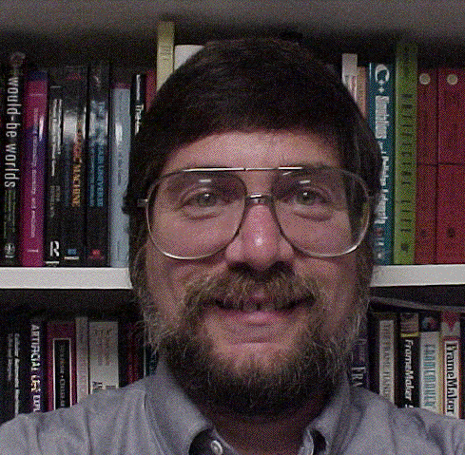

Meet Karel!
Merhaba
Tanıştığımıza memnun oldum
Notes:
He looks like an old machintosh machine.
Hes got legs… one sticks out the back. That’s just the way it is.

Slide 36

Karel Speaks Java
s
Notes:
Tomorrow you will learn that Karel is actually a very gentle introduction to programming

Slide 37

Karel’s World
North
3
+
+
+
+
+
2
+
+
+
+
+
West
East
1
+
+
+
+
+
South
1
2
3
4
5
Notes:
To you it might not be exciting but to karel its very exciting.

Slide 38

Walls
3
+
+
+
+
2
+
+
+
+
1
+
+
+
+
1
2
3
4

Slide 39

Beepers
3
+
+
+
+
2
+
+
+
+
1
+
+
+
+
1
2
3
4

Slide 40
Knows Four Commands
move();
turnLeft();
putBeeper();
pickBeeper();
Notes:
Tomorrow you will learn that Karel is actually a very gentle introduction to programming

Slide 41
move();

Slide 42

move();
3
+
+
+
+
2
+
+
+
+
1
+
+
+
+
1
2
3
4

Slide 43
move();
3
+
+
+
+
2
+
+
+
+
1
+
+
+
+
+
1
2
3
4

Slide 44
turnLeft();

Slide 45
turnLeft();
3
+
+
+
+
2
+
+
+
+
1
+
+
+
+
+
1
2
3
4

Slide 46
turnLeft();
3
+
+
+
+
2
+
+
+
+
1
+
+
+
+
+
1
2
3
4

Slide 47
pickBeeper();

Slide 48
pickBeeper();
3
+
+
+
+
2
+
+
+
+
1
+
+
+
+
+
1
2
3
4

Slide 49
pickBeeper();
3
+
+
+
+
2
+
+
+
+
1
+
+
+
+
+
1
2
3
4

Slide 50
Make Sense?

Slide 51
First Challenge
3
+
+
+
+
2
+
+
+
+
1
+
+
+
+
1
2
3
4

Slide 52
First Challenge
3
+
+
+
+
2
+
+
+
+
1
+
+
+
+
1
2
3
4

Slide 53
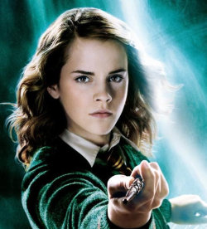
Need a Volunteer

Slide 54

Lets Try It

Slide 55
Anatomy of a Program
import stanford.karel.*;
public class OurKarelProgram extends Karel {
public void run() {
move();
pickBeeper();
move();
turnLeft();
move();
turnRight();
move();
putBeeper();
move();
}
private void turnRight() {
turnLeft();
turnLeft();
turnLeft();
}
}

Slide 56
Anatomy of a Program
import stanford.karel.*;
public class OurKarelProgram extends Karel {
public void run() {
move();
pickBeeper();
move();
turnLeft();
move();
turnRight();
move();
putBeeper();
move();
}
private void turnRight() {
turnLeft();
turnLeft();
turnLeft();
}
}
This is the program's source code

Slide 57
Anatomy of a Program
import stanford.karel.*;
public class OurKarelProgram extends Karel {
public void run() {
move();
pickBeeper();
move();
turnLeft();
move();
turnRight();
move();
putBeeper();
move();
}
private void turnRight() {
turnLeft();
turnLeft();
turnLeft();
}
}
This piece of the program's source code is called a method.

Slide 58
Anatomy of a Program
import stanford.karel.*;
public class OurKarelProgram extends Karel {
public void run() {
move();
pickBeeper();
move();
turnLeft();
move();
turnRight();
move();
putBeeper();
move();
}
private void turnRight() {
turnLeft();
turnLeft();
turnLeft();
}
}
This line of code gives the name of the method
(here, run)

Slide 59
Anatomy of a Program
import stanford.karel.*;
public class OurKarelProgram extends Karel {
public void run() {
move();
pickBeeper();
move();
turnLeft();
move();
turnRight();
move();
putBeeper();
move();
}
private void turnRight() {
turnLeft();
turnLeft();
turnLeft();
}
}
This line of code gives the name of the method
(here, turnRight)

Slide 60
Anatomy of a Program
import stanford.karel.*;
public class OurKarelProgram extends Karel {
public void run() {
move();
pickBeeper();
move();
turnLeft();
move();
turnRight();
move();
putBeeper();
move();
}
private void turnRight() {
turnLeft();
turnLeft();
turnLeft();
}
}
This is called an import statement. It tells Java what Karel is.

Slide 61
Anatomy of a Program
import stanford.karel.*;
public class OurKarelProgram extends Karel {
public void run() {
move();
pickBeeper();
move();
turnLeft();
move();
turnRight();
move();
putBeeper();
move();
}
private void turnRight() {
turnLeft();
turnLeft();
turnLeft();
}
}
This is called a code block

Slide 62
Anatomy of a Program
import stanford.karel.*;
public class OurKarelProgram extends Karel {
public void run() {
move();
pickBeeper();
move();
turnLeft();
move();
turnRight();
move();
putBeeper();
move();
}
private void turnRight() {
turnLeft();
turnLeft();
turnLeft();
}
}

Slide 63
Method Definition
private void name() {
statements in the method body
}
This adds a new command to Karels vocabulary

Slide 64
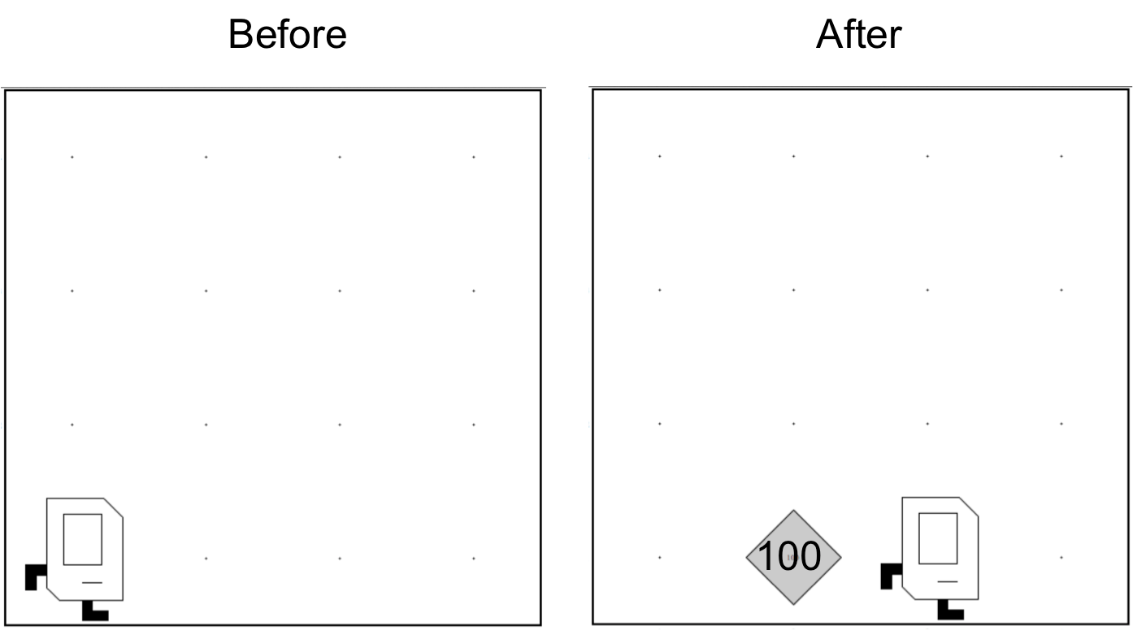
Place 100 beeper?

Slide 65

Learn By Doing

Slide 66
Logistics
http://csbridge.org/teachers

Slide 67
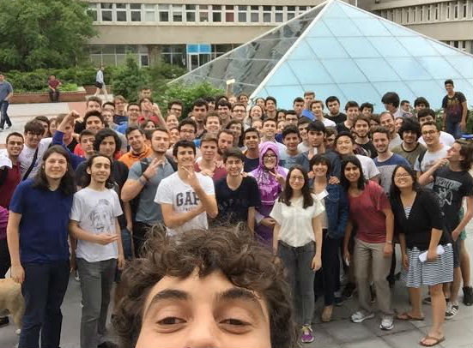
Computer Scientists

